Slide 1
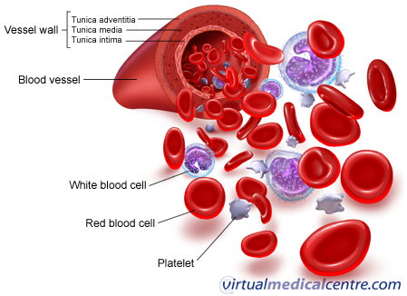
VASCULITIS:inflammatory diseases of blood vessels
Prepared by:Preju Sama Shrestha
Bpt 8th batch (2nd year)

Slide 2
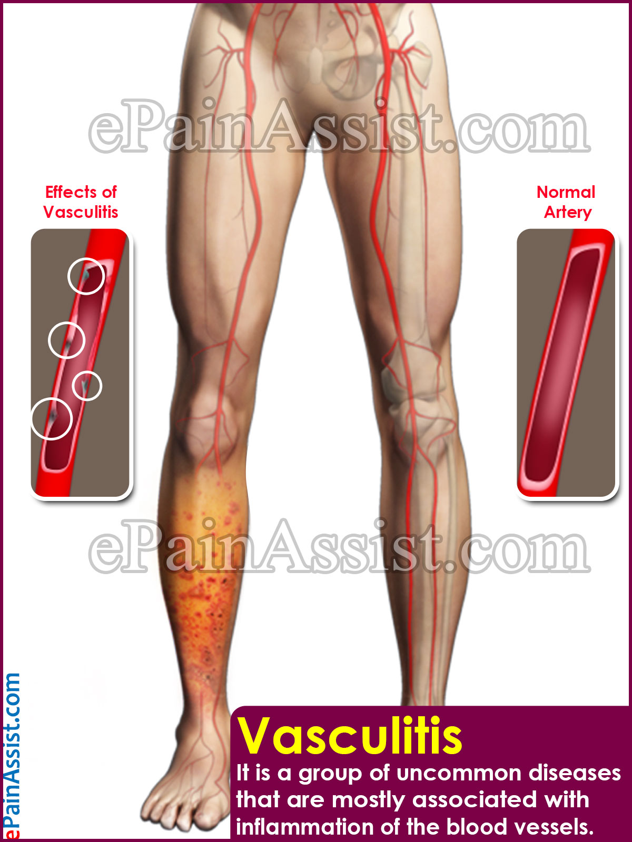

Slide 3
Vasculitis
Vasculitis is a heterogeneous group of disease characterised by inflammation and necrosis of blood vessel walls especially walls of arteries .
It is associated with damage to skin ,kidney,lungs ,heart ,brain and GIT.
It can be mild and transient affecting only skin to life threatening fulminant disease with multiple organ failure.

Slide 4
Clinical features are due to:
Local tissue ischemia(blood vessels narrowing)
Systemic effects of widespread inflammation

Slide 5
When inflamed, the blood vessel may become weakened and stretch forming an aneurysm, or become so thin that it ruptures resulting in bleeding into the tissue.
Vasculitis can also cause blood vessel narrowing to the point of closing off the vessel entirely. This can cause organs to become damaged from loss of oxygen and nutrients that were being supplied by the blood.

Slide 6
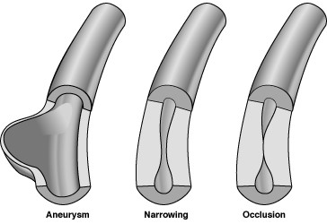

Slide 7
Pathophysiology of vasculitis

Slide 8
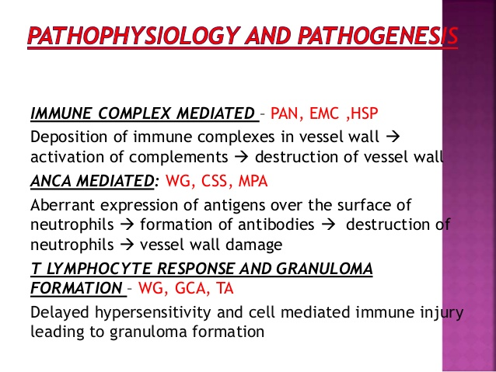

Slide 9
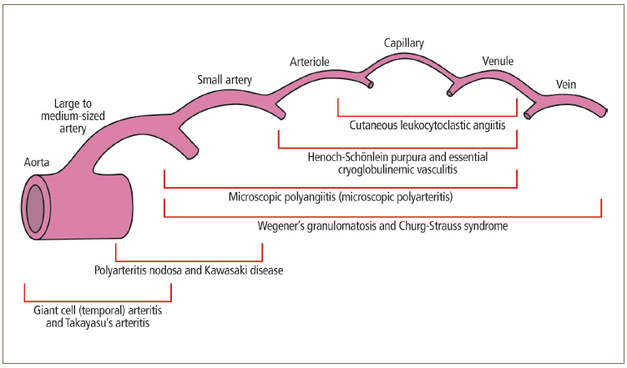
Classification of vasculitis

Slide 10
Classification depending upon size of artery involved in pathology
Large vessel vasculitis
Giant cell arteritis
Takayasu's vasculitis
Medium vessel vasculitis
Polyarteritis Nodosa
Kawasacki disease
ThromboangitisOblitetans/Burger's disease
Small vessel vasculitis
Cryoglobilinemic vasculitis
Henoch-Schonlein Purpura
Churg-strauss syndrome
Wegener Granulomatosis
Microscopic polyangitis

Slide 11
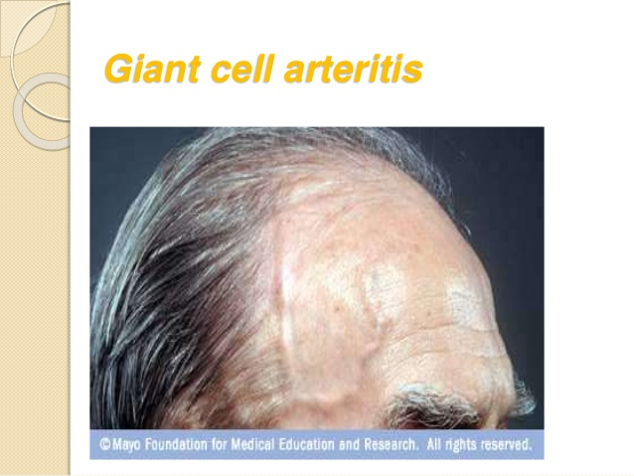
Giant cell arteritis(GCA)

Slide 12
Giant cell arteritis /temporal arteritis/cranial arteritis
Its is a large vessel vasculitis mainly affecting branches of temporal and ophthalmic arteries.It is a common form of vasculitis in adults.
GCA is one of the most common causes of vaculitis, with population-based studies suggesting an incidence of 2–76 per 100,000.
Common age of onset=over 50 years, and those aged 70–80 are
10 times as likely to develop GCA .

Slide 13
Clinical features
Headache with scalp tenderness(83-97 %)
Jaw pain while talking or chewing : this is due to ischemia of masseters(.42-50%)
Visual disturbance due to involvement of optic artery.This can also cause blurred vision and permanent blindness Fever and weight loss Synovitis.
Transient ischemic attack, brain stem infracts and hemiparesis may occur.
The most common systemic symptoms include those of polymyalgia rheumatica (PMR), which are fever, weight loss,malaise, morning joint stiffness, and proximal limb girdle pain
On examination there may be painful restrictions of active shoulder movements but passive movements are preserved and muscles may be tender in PMR

Slide 14
Takayasu's disease
It is a chronic granulomatous panarteritis(inflammation of all coats of blood vessel) affecting aorta and its branches and carotid,radial,ulnar and brachial arteries.
It is also called aortic arch disease or pulseless disease(due to absent peripheral pulse)

Slide 15
Sign and symptoms
The signs and symptoms of Takayasu's arteritis often occur in two stages.
Stage 1
Fatigue
Unintended weight loss
Muscle and joint aches and pains
Mild fever, sometimes accompanied by night sweats
Stage 2
Weakness or pain in your limbs with use
Lightheadedness, dizziness or fainting
Headaches or visual changes
Memory problems or trouble thinking
Chest pain or shortness of breath
High blood pressure
Diarrhea or blood in your stool
anemia

Slide 16
Risk factors
Takayasu's arteritis primarily affects girls and women younger than 40. The disorder occurs worldwide, but it's most common in Asia especially in Japanese women. Sometimes the condition runs in families.female:male ratio=8:1

Slide 17
Complications
Hardening and narrowing of blood vessels, which can cause reduced blood flow to organs and tissues
High blood pressure, usually as a result of decreased blood flow to your kidneys
Inflammation of the heart, which may affect the heart muscle or the heart valves
Heart failure due to high blood pressure, inflammation of the heart or aortic regurgitation — a condition in which a faulty aortic valve allows blood to leak back into your heart — or a combination of these
Stroke, which occurs as a result of reduced or blocked blood flow in arteries leading to your brain
Transient ischemic attack
Heart attack

Slide 18
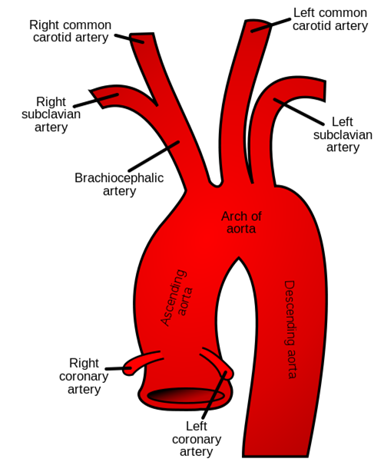
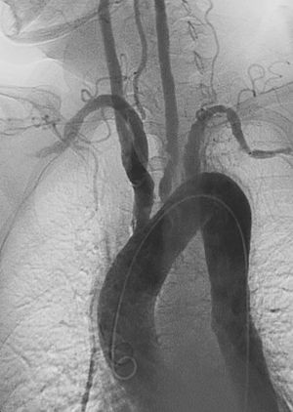
Left anterior oblique angiographic image of Takayasu's arteritis showing areas of stenosis in multiple great vessels

Slide 19
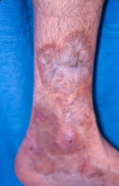
Polyarteritis Nodosa
Polyarteritis nodosa (PAN), also known as panarteritis nodosa,/periarteritis nodosa /Kussmaul disease
is a systemic necrotizing inflammation of blood vessels (vasculitis) affecting medium-sized muscular arteries, typically involving the arteries of the kidneys
PAN is associated with infection by the hepatitis B or hepatitis C virus.
PAN can occur at any age can be infant to adult but usually occur in 40-50 years
Male :female =2:1

Slide 20
Clinical features
Constitutional symptoms are seen in up to 90% of affected individuals and include fever, fatigue, weakness, loss of appetite, and unintentional weight loss.
Musculoskeletal system:Arthralgia and myalgia
The most common involved organ is kidney.It can progress to glomerulonephritis and retroperitoneal hemorrhage.
Lungs involvement is rare but pleurisy and lung infiltrates can occur.
Skin: palpreable purpura can be seen.
Heart:coronry heart disease(angina pectoris and infarction) ,pericarditis
Nervous system:stroke and TIA

Slide 21
Sign and symptoms
A patient is said to have polyarteritis nodosa if he or she has three of the 10 signs known as the 1990 American College of Rheumatology (ACR)[11] criteria, when a radiographic or pathological diagnosis of vasculitis is made:
Weight loss greater than/equal to 4.5 kg
Livedo reticularis (a mottled purplish skin discoloration over the extremities or torso)
Testicular pain or tenderness (occasionally, a site biopsied for diagnosis)
Muscle pain, weakness, or leg tenderness
Nerve disease (either single or multiple)
Diastolic blood pressure greater than 90 mmHg (high blood pressure)
Elevated kidney blood tests ( creatinine greater than 1.5 mg/dL)
Hepatitis B
angiogram showing the arteries that are dilated (aneurysms) or constricted by the blood vessel inflammation
Biopsy of tissue showing the arteritis (typically inflamed arteries):[12] The sural nerve is a frequent location for the biopsy.

Slide 22
Kawasacki disease
Kawasaki disease is a form of vasculitis characterized by inflammation of the blood vessels, which can restrict blood flow and damage vital organs and tissues.
Kawasaki primarily occurs in children from 6 months to age 5.
Also called mucocutaneous lymph node syndrome, the disease affects the mucus membranes, lymph nodes, and the coronary arteries which supply blood to the heart muscle.
It is the leading cause of acquired heart disease in children in the United States.

Slide 23
Speciality | Paediatric population
Symptoms | Fever > 5 days, large lymph nodes, rash, sore throat, diarrhea
Complications | Coronary artery aneurysm
Usual onset | < 5 years old
Duration | ~ 3 weeks
Causes | Unknown
Prognosis | Mortality 0.2% with treatment
Frequency | 8–124 per 100,000 people under five

Slide 24
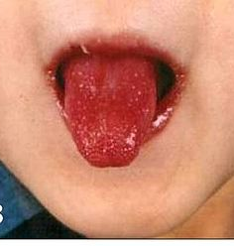
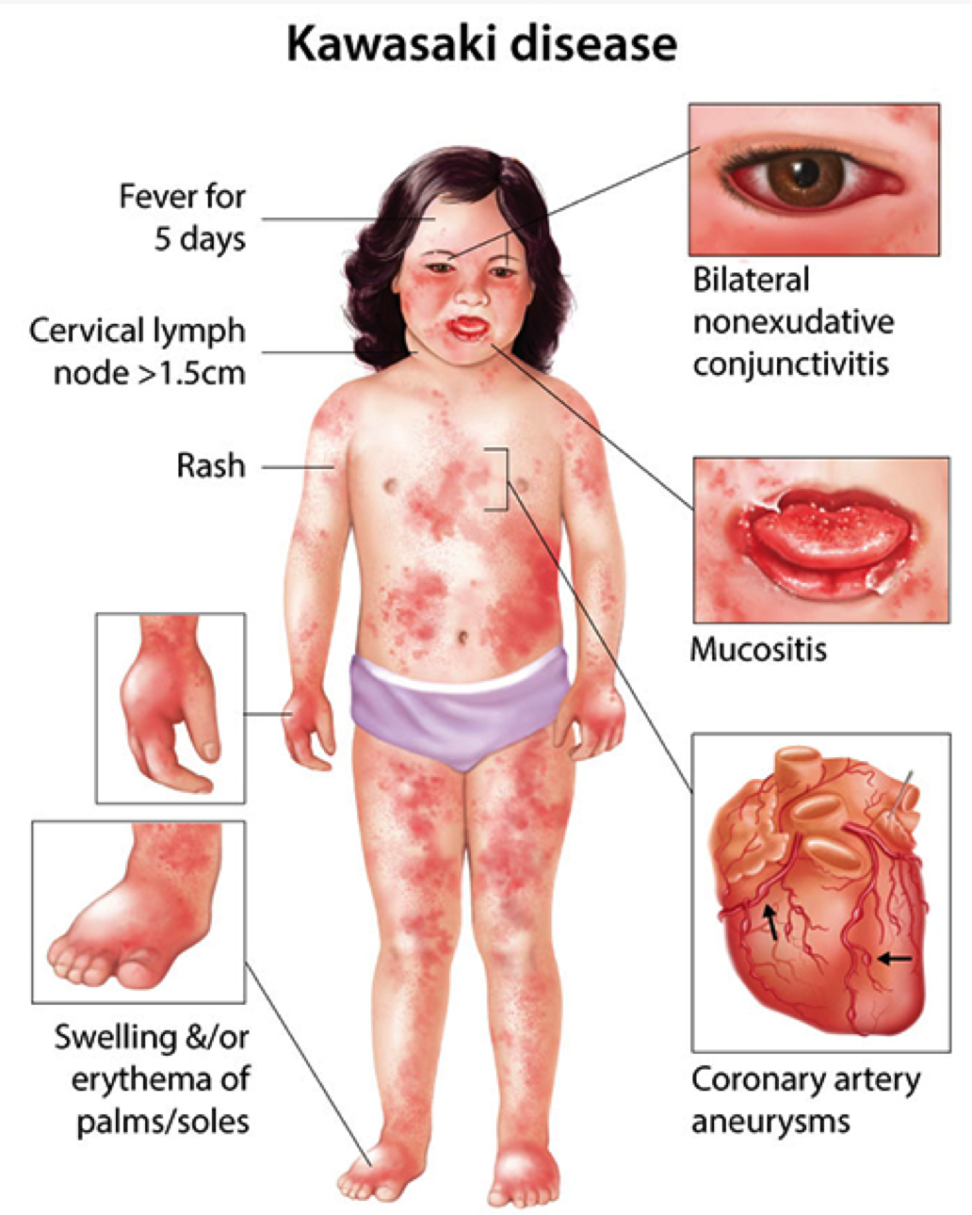
A child showing the characteristic "strawberry tongue" seen in Kawasaki disease

Slide 25
Thromboangitis obliterans /Burger's disease
TAO (Buerger’s disease) is an inflammatory, nonatherosclerotic disease affecting the small and medium-sized arteries and veins in both the upper and lower extremities.
Tobacco use plays a central role in both the initiation and the continuance of the disease and discontinuation of tobacco use in any form is the mainstay of treatment.
Amputation almost never occurs in patients who are able to discontinue using tobacco.
The legs are affected more often than the arms

Slide 26
Sign and symptoms
Tingling or numbness in the hands or feet.
Pale, reddish or blue-tinted hands or feet.
Pain that may come and go in your legs and feet or in your arms and hands. This pain may occur when you use your hands or feet and eases when you stop that activity (claudication), or when you're at rest.
Inflammation along a vein just below the skin's surface (due to a blood clot in the vein).
Fingers and toes that turn pale when exposed to cold (Raynaud's phenomenon).
Painful open sores on your fingers and toes.

Slide 27
Onset age | Before 45 years Mean age=42 years
Common cause | Cigarette and tobacco consumers Periorodontal infection
Epidemiology | most prevalent in the Mediterranean, Middle East, and Asia especially among people who make homemade cigarettes from raw tobacco
Gender | More common in men than women
Complications | Can cause gangrene and have to amputate the affected part
Rest pain | Present
Ishemic ulcers Upper extermity Lower extremity Both | 76% 28% 46%

Slide 28
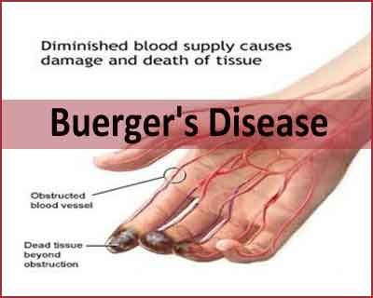
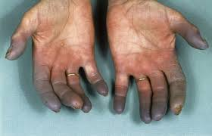
Thromboangitis obliterans /Burger's disease

Slide 29
Cryoglobulinemic vasculitis
Cryoglobulinemic vasculitis is a form of inflammation affecting the blood vessels caused by the deposition of abnormal proteins called cryoglobulins in the blood vessels.
Cryoglobulinemic vasculitis affects the skin and causes a rash.
Additionally, the kidneys may be affected by this form of vasculitis resulting in membranoproliferative glomerulonephritis.

Slide 30
Causes | Associated with hepatitis B virus and HIV virus infection Also contributed by genetic and environmental factors.
Clinical features | Skin lesions Chronic hepatitis Membranoproliferative glomerulonephritis Peripheral neuropathy
Epidemiology | approximately 1:100,000 (with a female-to-male ratio of 3:1)

Slide 31
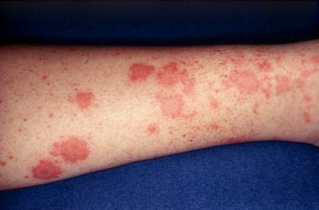
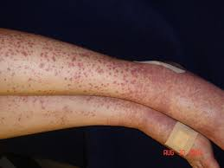
Cryoglobulinemic vasculitis

Slide 32
Henoch -Schonlein Purpura
It is a small vessel vasculitis caused by immune complex deposition following an infectious trigger.
This disease is normally self limiting disorder that settles down spontaneously without specific treatment.

Slide 33
Common age group | Children and young adults(3-15years?
Sign and symptoms | red to dark purple rash, called “purpura” on the legs and buttocks Painful swelling around joint Abdominal pain Kidney disease
Complications | Nephritis may occur and present upto 4 weeks after onset of other symptoms.
Epidemiology | most common form of vasculitis in children. It is more common in boys than girls. It rarely occurs in adults. HSP can occur at any time of the year, though it is more common in the winter.

Slide 34
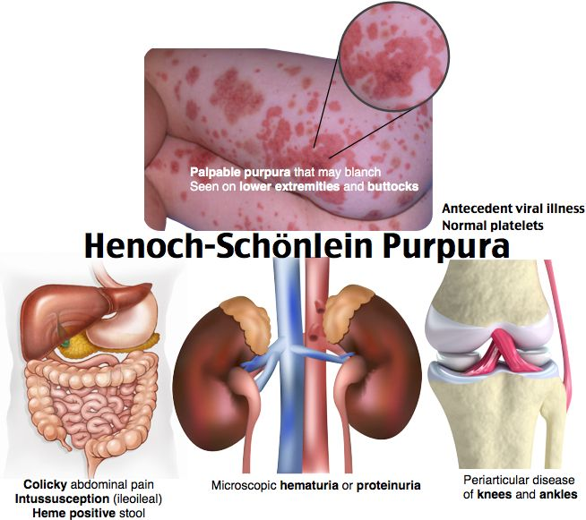

Slide 35
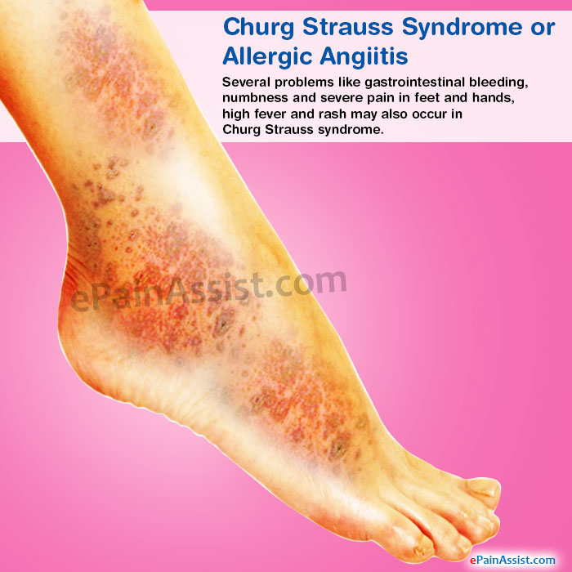

Slide 36
Churg-strauss syndrome
an extremely rare autoimmune condition that causes inflammation of small sized blood vessels in persons with a history of airway allergic hypersensitivity (asthma).
Also called Eosinophilic granulomatosis with polyangiitis (EGPA),
Asthma is the most common sign of Churg-Strauss syndrome.
The disorder can also cause a variety of other problems, such as hay fever, rash, gastrointestinal bleeding, and pain and numbness in your hands and feet

Slide 37
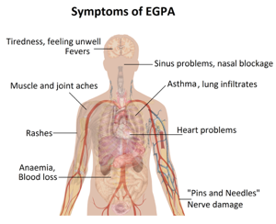

Slide 38
Microscopic polyangitis
Microscopic polyangiitis is a disease that results from small blood vessel inflammation that can result in damage to organ systems.
Areas most commonly affected by MPA include the kidneys, lung, nerves, skin, and joints.
The disease may occur in people of all ages, both genders, and all ethnic backgrounds.

Slide 39
The FIVE most common clinical manifestations of MPA are:
Kidney inflammation (~ 80% of patients).
Weight loss (> 70%).
Skin lesions (> 60%).
Nerve damage (60%).
Fevers (55

Slide 40
Wegener's disease / Granulomatosis with polyangitis
Granulomatosis with polyangiitis (GPA, formerly called Wegener’s) is a rare disease of uncertain cause.
It is the result of inflammation within the tissues called granulomatous inflammation and blood vessel inflammation ("vasculitis"), which can damage organ systems.
The areas most commonly affected by GPA include the sinuses, lungs, and kidneys, but any site can be affected.

Slide 41
GPA can occur in people of all ages. The peak age groups affected are from 40-60 years. It appears to affect men and women equally.
General signs of the disease may include:
Loss of appetite
Weight loss
Fever
Fatigue

Slide 42
Most patients first notice symptoms in the respiratory tract. Symptoms may include:
Persistent runny nose (also called rhinorrhea)
Nasal or facial pain
Nose bleeds or unusual nasal discharge
Cough that might include bloody mucus
Chest discomfort with or without shortness of breath
Middle ear inflammation (also called otitis media)
Voice change, wheezing

Slide 43
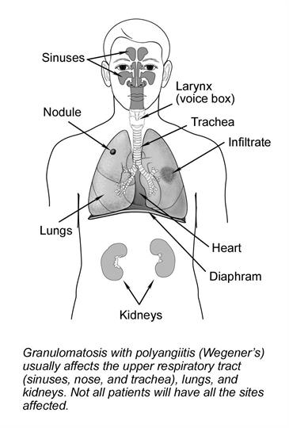

Slide 44
Assessment of vasculitis
SUBJECTIVE ASSESSMENT
Demographic data:
Name
Age
Type of vasculitis | Age
Giant cell arteritis | Over 50 years
Takayasu vasculitis | Younger than40 years
Polyarteritis nodosa | Can be in infant to adult but mainly in 40 -50years individuals

Slide 45
Kawasacki disease | 6 months to 5years children
Burger's disease | 42 years
Henoch-Schonlein purpura | Children and young adults(3-12years)
Wegener's disease | 40-60years
Microscopic polyangitis | All age groups

Slide 46
Gender:
Common in male:takayasu arteritis , thromboangitis obliterans ,
Common in female:giant cell arteritis ,polyarteritis nodosa ,
Both:microscopic polyangitis ,Wegener's disease
Education level:if patient is educated then they have bette ability to understand their health status and cooperate with therapy.
Date of admission and examination

Slide 47
Chief complain:includes common symptoms like severe headache,fever, weight loss,rashes in skin,night sweating,ache in body ,numbness etc.
HOPI(history of present illness):
Initially patient feels fatigue,headache ,fever with night sweats followed by unintended weight loss.
Later it may progress to disturbance in vision,chest pain ,shortness of breath and pain in joint and muscles.

Slide 48
Cough:persistent cough in large vessel vasculitis
Associated symptoms:night sweats,weight loss,headache,fever,dizziness
Dypsnea:seen in giant cell vasculitis and Takayasu disease
Chest pain:present in large vessel vasculitis
Fever:mild fever
Past medical history:
Polyarteritis nodosa associated with hepatitis
Churg-strauss syndrome associated with asthma
Personal history:
Thromboangitis obliterans due to intake of tobacco
Lifestyle history:unrecognized obstructie sleep apnea can cause vasculitis.

Slide 49
Occupational history:exposure to sillica and metals can caue small vessel vasculitis.
Farming in lifetime has been show to associated with primary systemic vasculitis.
OBJECTIVE ASSESSMENT:
Vital signs
Temperature:mild fever
>5 days in Kawasaki disease
Pulse rate:pulseless in Takayasu's disease
Blood pressure: Hypertension can be seen
Diastolic pressure greater than 90mmhg

Slide 50
Inspection ad observation
Head:
distinct blood vessel in head eg temporal artery in giant cell arteritis
Excessive sweating at night
Eyes:diplopia and blurred vision
Extremities:
Poor capillary refill
Finger and toes are pale ,reddsih or blue tinted in thromboangitis obliterans
Skin rashes and lesions on lower extremity especially ankle and buttocks.
Muscle and joint ache and tenderness
Swelling of foot in Kawasaki disease

Slide 51
Auscultation
Blockage in the large sized artery can be auscultate from the skin above and bruit and thrill sound can be heard.

Slide 52
References
Robbins basic pathology; kumar Abbas Aster; 9th edition.
Davidson’s principles and practice of medicines, 21st edition
www.hopkinsvasculitis.org
www.myoclinic.org /vasculitis
Mythili Seetharaman,MD consultant rheumatologist, giant cell arteritis ( temporal arteritis), medscape.
Naiem Nassiri, MD, Thromboangiitis obliterans. Nov 19,2015 ( MEDSCAPE)
PERIPHERAL ARTERIAL DISEASE by HUMANA PRESS
ABC of arterial and vascular disease COS Savge et al
Vascular inflammation in obesity by jelicS et al

Slide 53


Slide 54

Any queries?

Slide 55
Inflammation of blood vessels
Blood vessel ruptures and bleeding into tissue
Blood vessel become weaken and stretched :aneurysm
Narrowing of blood vessels
Lack of nutrients and oxygen to supplying tissue by blood vessel
Necrosis and cell death

Slide 56
Clinical features are due to
vasculitis
Systemic effects of widespread inflammation
Local tissue ischemia due to blood vessel narrowing

